Slide 1


Rest Assured API Automation
Day 4 - Code Optimization and Framework Overview

Slide 2
Reusable Request Specifications
Hard-coded the entire API path into our tests themselves. This might lead to a lot of rework in case an API base URL changes or you want to run your tests against multiple environments.
The mechanism that REST Assured offers to enable us to create flexible and reusable requests specifications is called a RequestSpecification.
RequestSpecBuilder : use the builder to construct a request specification
Create a new RequestSpecBuilder and tell it setBaseUri("http://api.zippopotam.us") as the base URI so that we don't need to specify that in tests again.
Similar to baseUri, we can setup content-type, headers with spec builder object so that we don’t have to set those values in each tests again.

Slide 3
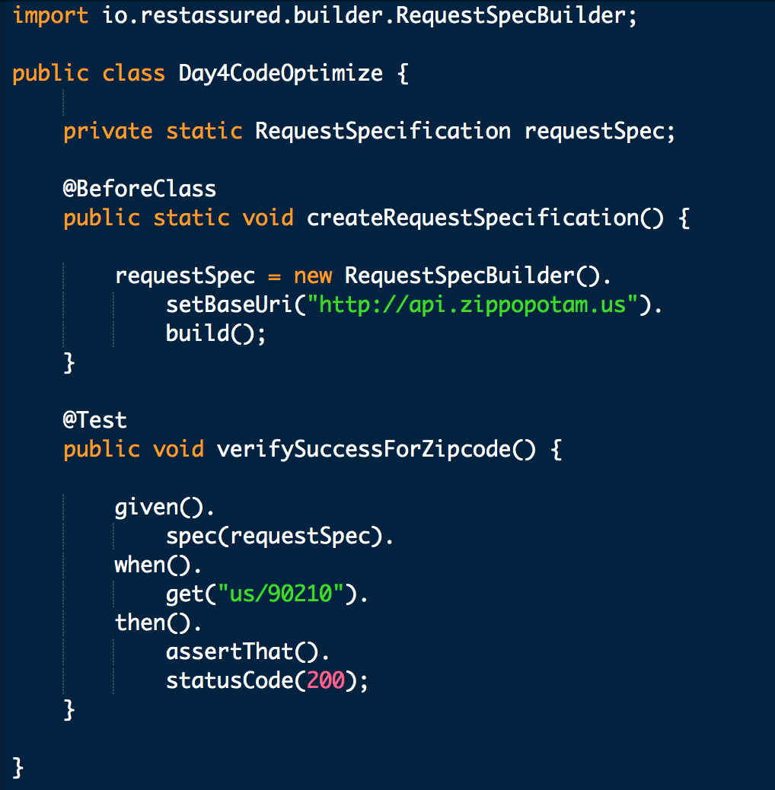
Reusable Request Specifications example

Slide 4
Reusable Response Specifications
Ability to reuse response checks. example For all tests, want to do an assertion on the responses that check HTTP status code is 200 and content type is JSON.
Avoid lot of duplicate code on each test cases for above assertions.
REST Assured offers the ResponseSpecification mechanism. It works to specify common characteristics for the responses that are returned from the API calls or common checks that we want to perform on those responses.

Slide 5
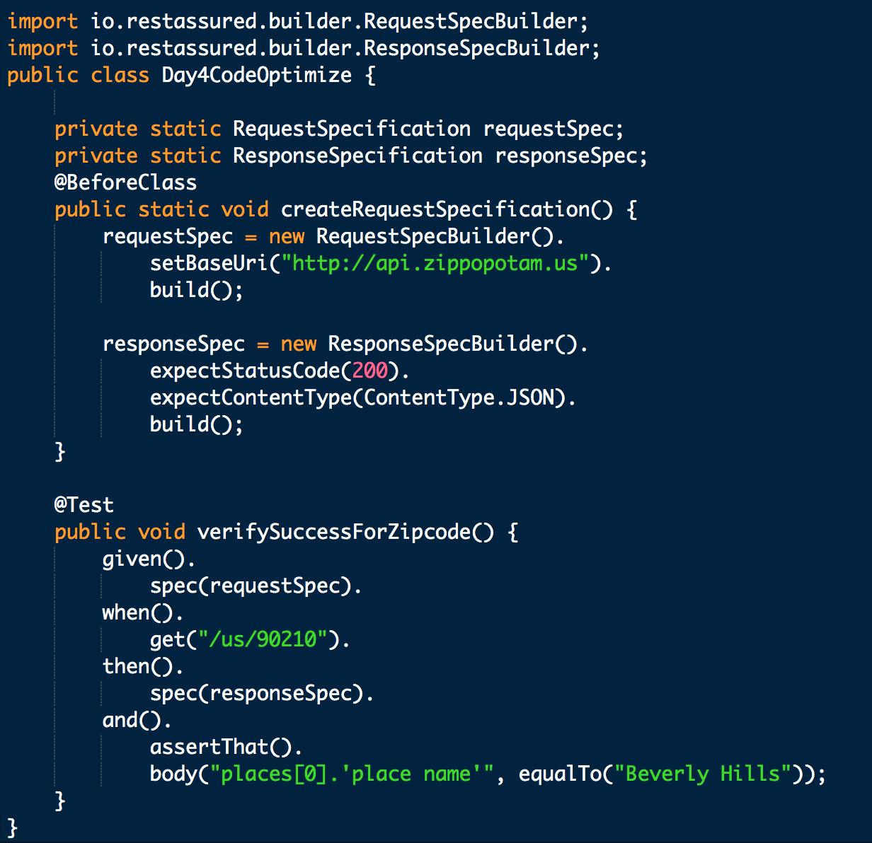
Reusable Response Specifications example
So, when we run test, we see that the test passes, telling us that the status code matches the expected value of 200, that the content type was indeed equal to JSON and that the first place name in the list of places returned by the API was equal to "Beverly Hills".

Slide 6
Extracting Response Values for Reuse
Extract values, element values from individual responses from API calls and storing them for later reuse.
Example: Performing an API call prior to a test run that retrieves an authentication token for an API that's secured with the OAuth authentication mechanism and then being able to reuse that token in all subsequent REST Assured tests.
Instead of directly specifying the assertions into our REST Assured test code itself, we can use the extract method to store the response field.

Slide 7
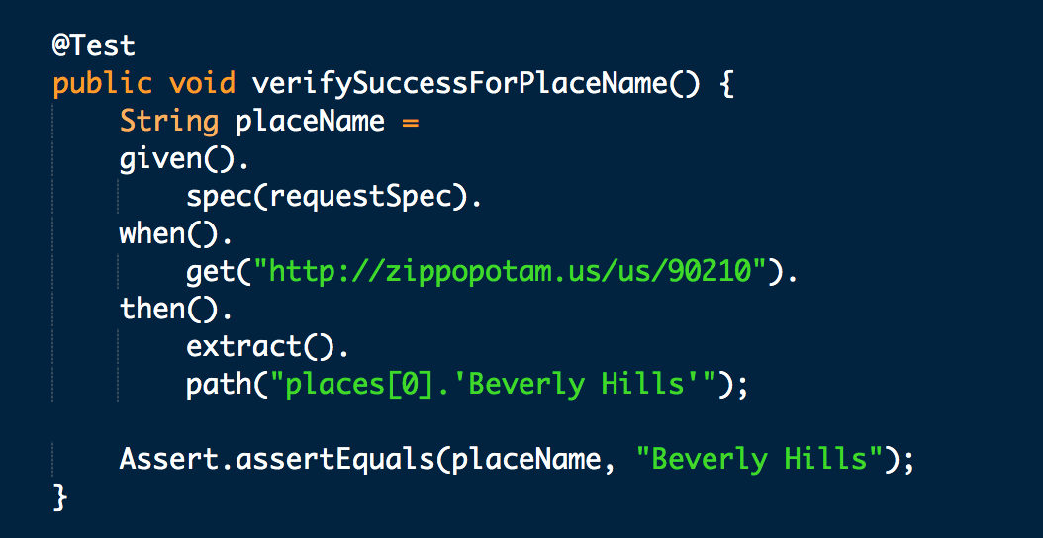
Extracting Response Values for Reuse Example
In this case, it will extract the place name of the first place in the list of places that's being returned by the API, store it in a local String placeName.
Then perform an assertion on it to demonstrate that the place name that's being extracted from the API response is actually equal to "Beverly Hills"

Slide 8
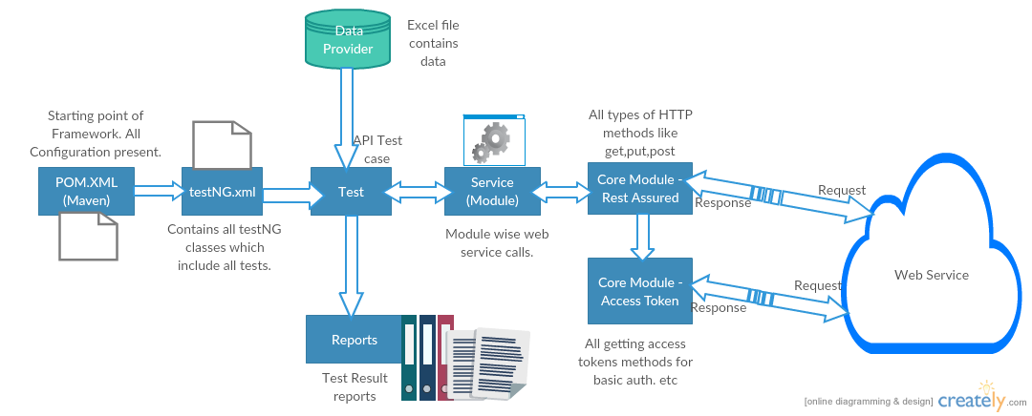
Framework Overview

Slide 9


